Slide 1
Qlik Gold Client
Export Dashboard
June 3, 2020
Grisell Torres
Software Engineer

Slide 2

Intro
Presenter Bio:
Grisell Torres
Software Engineer
grisell.torres@qlik.com
Background:
5 years with Attunity/Qlik
More than 15 years of experience in SAP, mostly functional focus in MM, WM modules and 2 years of SAP Archiving.
Gold Client background: ECC, CRM, GTS, HR and BW.
  Add-ons: IS-Utilities, IS Retail and Vistex

Slide 3
Agenda
Introduction
    Presenter Bio
    Purpose & Objetives of this workshop
      User cases
Testing Data Challenges
Gold Client Technical Solution
    How to Export and create scenarios with Data Snap
    How to create Export ID and Add Containers to it
    How to reuse and update scenarios
    How to refresh test data in the target system
Best Practices
Resources Available
    Data Echo User Guide
    Support Site
Questions
Next Steps

Slide 4
Purpose & Objectives
  In this workshop we will discuss how Gold Client can help with ad-hoc data refresh process.
    - The focus will be the Export Control option, to understand the process and to reuse scenarios and data for testing.
  Use Case:
    Problem: On-going testing activities on a non-production system requires fresh data, both Master and transactional.
    Solution: Since testing activities are more concerned with data quality and not data quantity, copying only specific data segments is typically required. Gold Client can be used to copy the relevant data.
      Data Echo – Data Snap and Export Control can be used for this purpose.
      Data Echo – Import Control will be used to manage the import process.
      Data Discard – Delete Data can be used to remove data that has been used during testing; then initial data set can be imported again for subsequent testing.

Slide 5
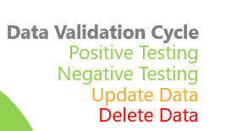
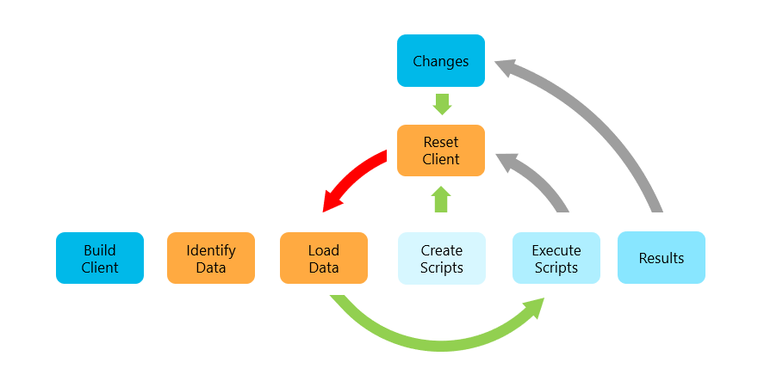
Testing Data Challenges
  Lack of Quality Control in development lifecycle
    Data in DEV is too stale to use for unit testing, therefore, changes are oftentimes promoted to QA with little or no testing
  Testing Data quality and quantity
    Testing data quickly becomes exhausted and requires manual creation of new test data

Slide 6
GOLD CLIENT TECHNICAL SOLUTION

Slide 7
Best Practices
  Gold Client Best Practices for copying data:
The servers being used to perform the export and the import must use the same operating system (e.g. Unix versus Linux)
When importing, it’s best to replace data which already exists in the target client (a.k.a. “conflicting data”) to help maintain data integrity
When copying volumes of data, particularly from Production, do so when the system is the most quiet (after hours, evenings, weekends) so as to avoid possible data inconsistency issues in the target client because of the data having changed during the export process
When deleting data in the target client, consider carefully whether to delete the master data or if it’s okay to just target the transactional data
Review and update scenario variables as needed – particularly those that are date oriented; this is particularly useful prior to copying a new time slice of data

Slide 8
Questions?

Slide 9
Next Steps
Gold Client Documentation
    https://help.qlik.com (no logon requied)
      Qlik Gold Client
        ERP 8.6 (ECC, S4, HR, CRM, SRM, GTS, EWM, TM, MDG)
        BW 3.3.5
        SCM 2.2
        Data Protection 1.0 (GDPR)
  Gold Client Support
    https://attunitysupport.qlik.com
  Gold Client Community
    https://community.qlik.com
      Qlik Data Integration Forums
        Qlik Gold Client

