Slide 1
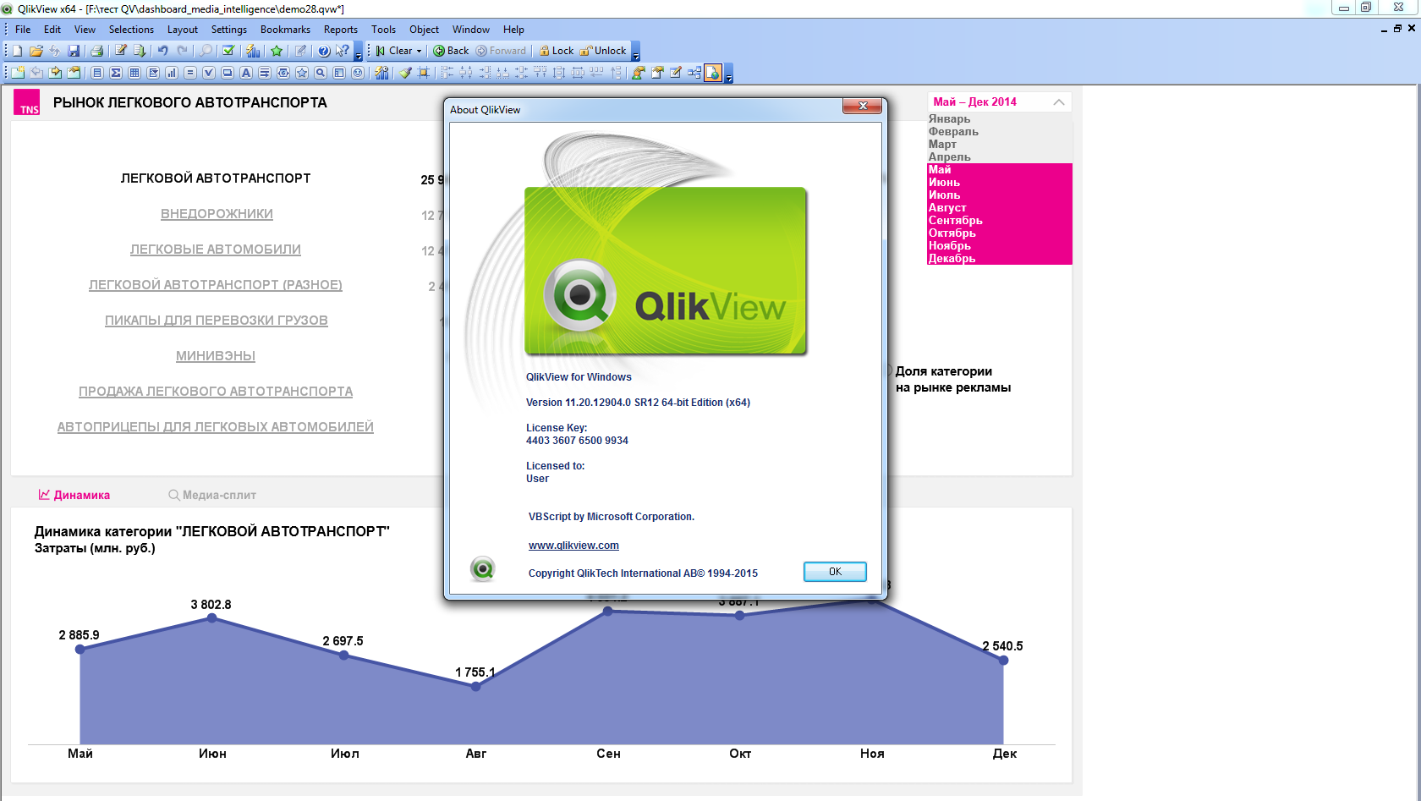
I applied an intense shadow to this object.
Why there is no shadow in web view?

