Slide 1
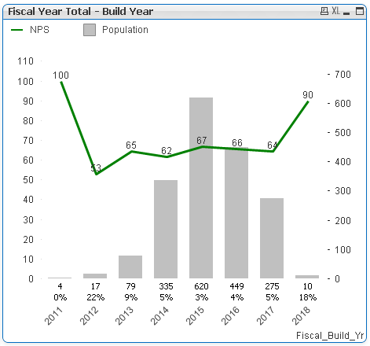
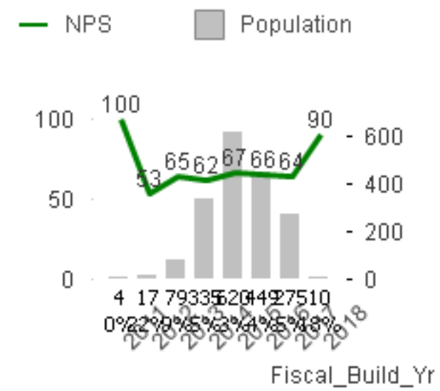
ORIGINAL
COPIED TO CLIPBOARD AS IMAGE AND THEN PASTED HERE

