Slide 1
QlikView Connector for SAP NetWeaver

Slide 2
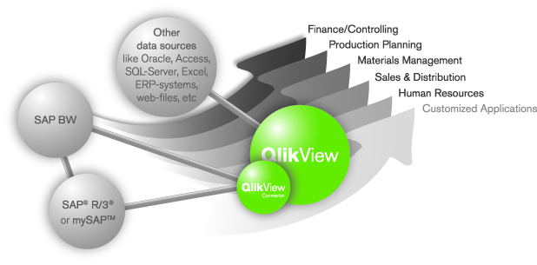

Co-Existence of SAP BI and Other Sources
Consolidated view of all information
Leverages SAP and DWH investments
Excellent performance
Self-service BI, ease of use
Mobile availability
Rapid development of new applications
Seamless access to detailed transaction data
Reduction of SAP BI complexity and TCO
Seamless integration of non-SAP data
Single, intuitive, integrated front end

Slide 3
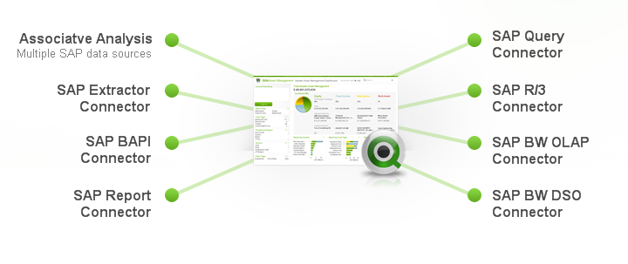
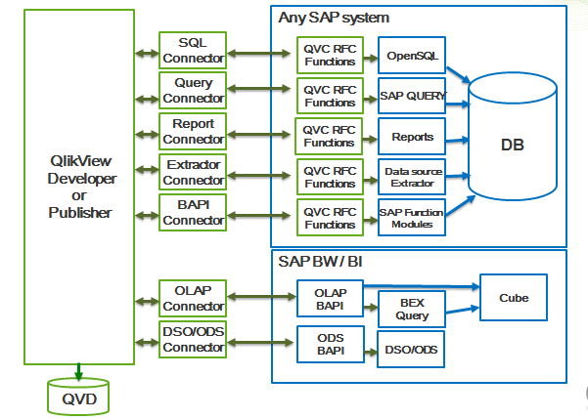
Certified QlikView Connector for SAP®
QlikView Connector for use with SAP Netweaver®
Enables SAP customers to get easy and quick access to all the data hidden in different SAP systems
SAP data can then easily be combined with Non-SAP data within individual QV-analytical applications
Creates value out of SAP systems within a few weeks – rather than months/years
Certfiied by SAP

Slide 4
QlikView® SAP Connector
QlikView
Developer
or
Publisher
SQL
Connector
Any SAP system
QVC RFC
Functions
OpenSQL
Query
Connector
DB
QVC RFC
Functions
OpenSQL
Report
Connector
QVC RFC
Functions
OpenSQL
SAP BW / BI
OLAP
Connector
Cube
OLAP
BAPI
BEX
Query
DSO/ODS
Connector
ODS
BAPI
DSO/ODS
QVD
SQL
Connector

Slide 5
What is the QlikView® Connector?
Remote Function Call connection to SAP
SAP becomes a “standard” data source for QV Development
6 connectors, SQL based and MDX based (for BW info cubes/queries)
Provides QlikView Script Builder Application
Opens the door for quick and easy development of any kind of analytical application within QlikView
Reads SAP data dictionary
Reads Cluster, Pool and Transparent tables
Including SAP Metadata
Extracts tables/views from SAP (standard or custom Z* and Y*)
Extracts BW info cubes/BEX queries or ODS/DSO
Compatible with R/3 >= 4.6C and BW >= 3.1
Initial certification December 2006
Recertified April 2009
Extracts from SAP queries

Slide 6
Using QlikView, SAP® customers can:
Expand acceptance and enterprise use of analytics to make decisions that drive business performance
Free your SAP Data
No need for a data warehouse
Combine data easily from SAP® R/3®, mySAP™, SAP BW and non-SAP sources
Empower users to perform their own analysis with simplicity, reducing required IT support for BI by up to 90%
Give users the ability to visualize information in a wide variety charts, graphs and tables
Reduce the time to make critical business decisions by weeks
Implement or upgrade analytics for any existing SAP® infrastructure within days, not months

Slide 7
Technical Benefits
Access to SAP data using SAP latest Netweaver RFC
No dependencies on other products (e.g. SAPGUI, Bex)
Field level security
Zero administration
One connector to multiple SAP servers (DEV, QAS, PRD)
Parallel downloads
No extra hardware (coexists with QV Development and Publisher)
Quick installation and configuration (1/2 hr)
Automatic ETL script generation based on easy point and click selection using Qlikview Script Builder application
Follows SAP security model
Delta load capable

Slide 8
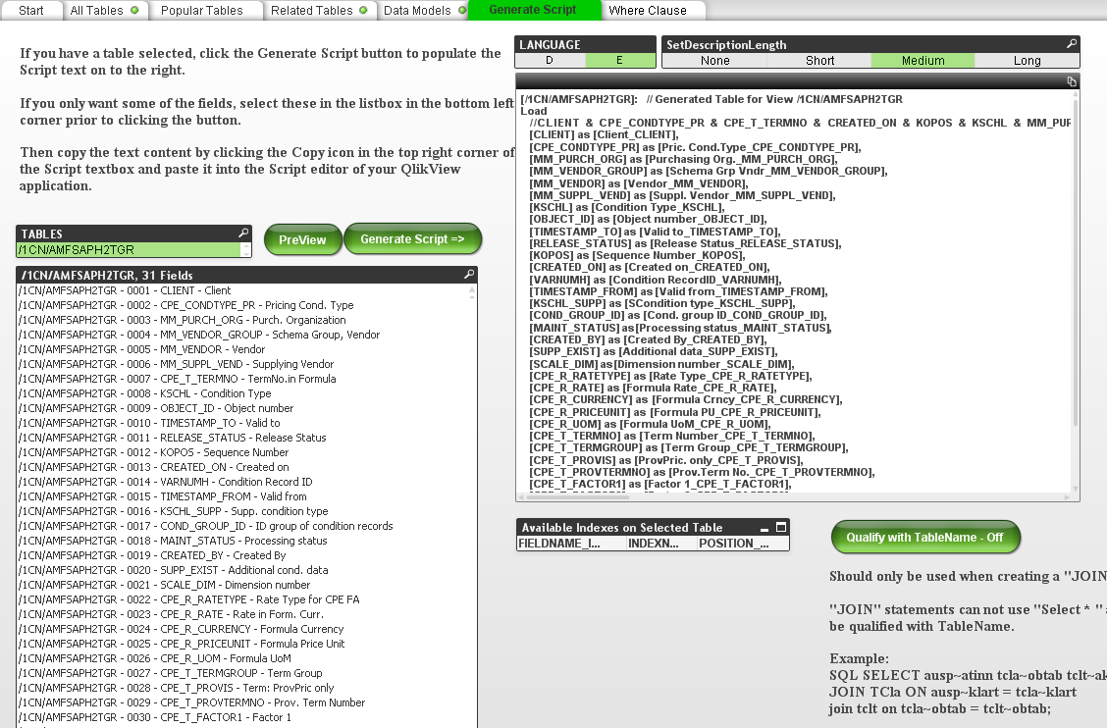
Script Builder
Reads you SAP Data Dictionary
Allows you to find tables
Generates the required scripts for QlikView
References Business Names

